Slide 1
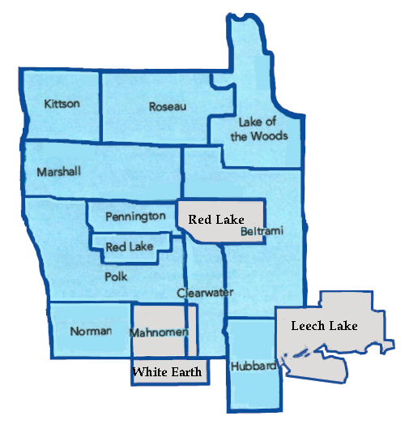
NWCoC – Public Housing Authorities Emergency Housing Voucher Information Session
DATE 08/17/2021
Northwest Continuum of Care (NWCoC) – Cory Boushee, COC Coordinator – coryb@nwmf.org; and
Lori Anderson, Priority List Manager- delores@tvoc.org
Northwest Multi-County Housing Authority – Karen Lunak, Housing Director - Karen@nwmnhra.org
HRA of Bemidji – Debbie Wold, Executive Director - hradw@midconetwork.com

Slide 2
Agenda
HRA Service Areas
Emergency Housing Voucher (EHV) Program Overview
Program Eligibility
How do I refer my client / access EHV
Process and Marketing thoughts
Open Question and Answer Session

Slide 3
HRA Service Areas
HRA of Bemidji
Counties Served
Beltrami, Clearwater, and Mahnomen
NW Multi-County HRA
Counties Served
Kittson, Lake of the Woods, Marshall, Norman, Pennington, Polk, Red Lake, and Roseau
Someone from Hubbard County would need to be referred through the CoC to either agency.

Slide 4
Overview of the EHV Program
The Emergency Housing Voucher (EHV) program is available through the American Rescue Plan Act (ARPA). Through EHV, HUD is providing 70,000 housing choice vouchers to local Public Housing Authorities (PHAs) in order to assist individuals and families who are:
Homeless,
At risk of homelessness,
Fleeing, or attempting to flee, domestic violence, dating violence, sexual assault, stalking, or human trafficking, or
Were recently homeless or have a high risk of housing instability.
What makes these vouchers different?
Clients who owe money to the HRA are eligible.
The HRA can support the client with a variety of options. (We will go over in more detail)
A significant amount of funding has been made available to be appropriated for this program. Once that funding is expensed the program will no longer receive funding. Though clients will most likely be absorbed into the regular Housing Choice Voucher and not lose their housing.
Any member of the family who has been evicted from federally assisted housing in the last 5 years are eligible.
A PHA that has ever terminated assistance under the program for any member of the family is eligible.
Vouchers become portable right away.
Initial Voucher issuance will be for 120 days.
Who is not eligible?
Anyone convicted of making meth in a federally assisted housing facility.
Anyone with a household member subject to lifetime sex offender registry.
Engaging in violent criminal activity in the last 12 months.
Past threatening or violent behavior towards Public Housing Authority Staff.
After September 30, 2023 a PHA may not reissue the EHV to another household. Prior to September 30, 2023 if a household gives up their voucher then we can reissue to another household.
Have until September 30th to fill all vouchers – Hopefully faster.

Slide 5
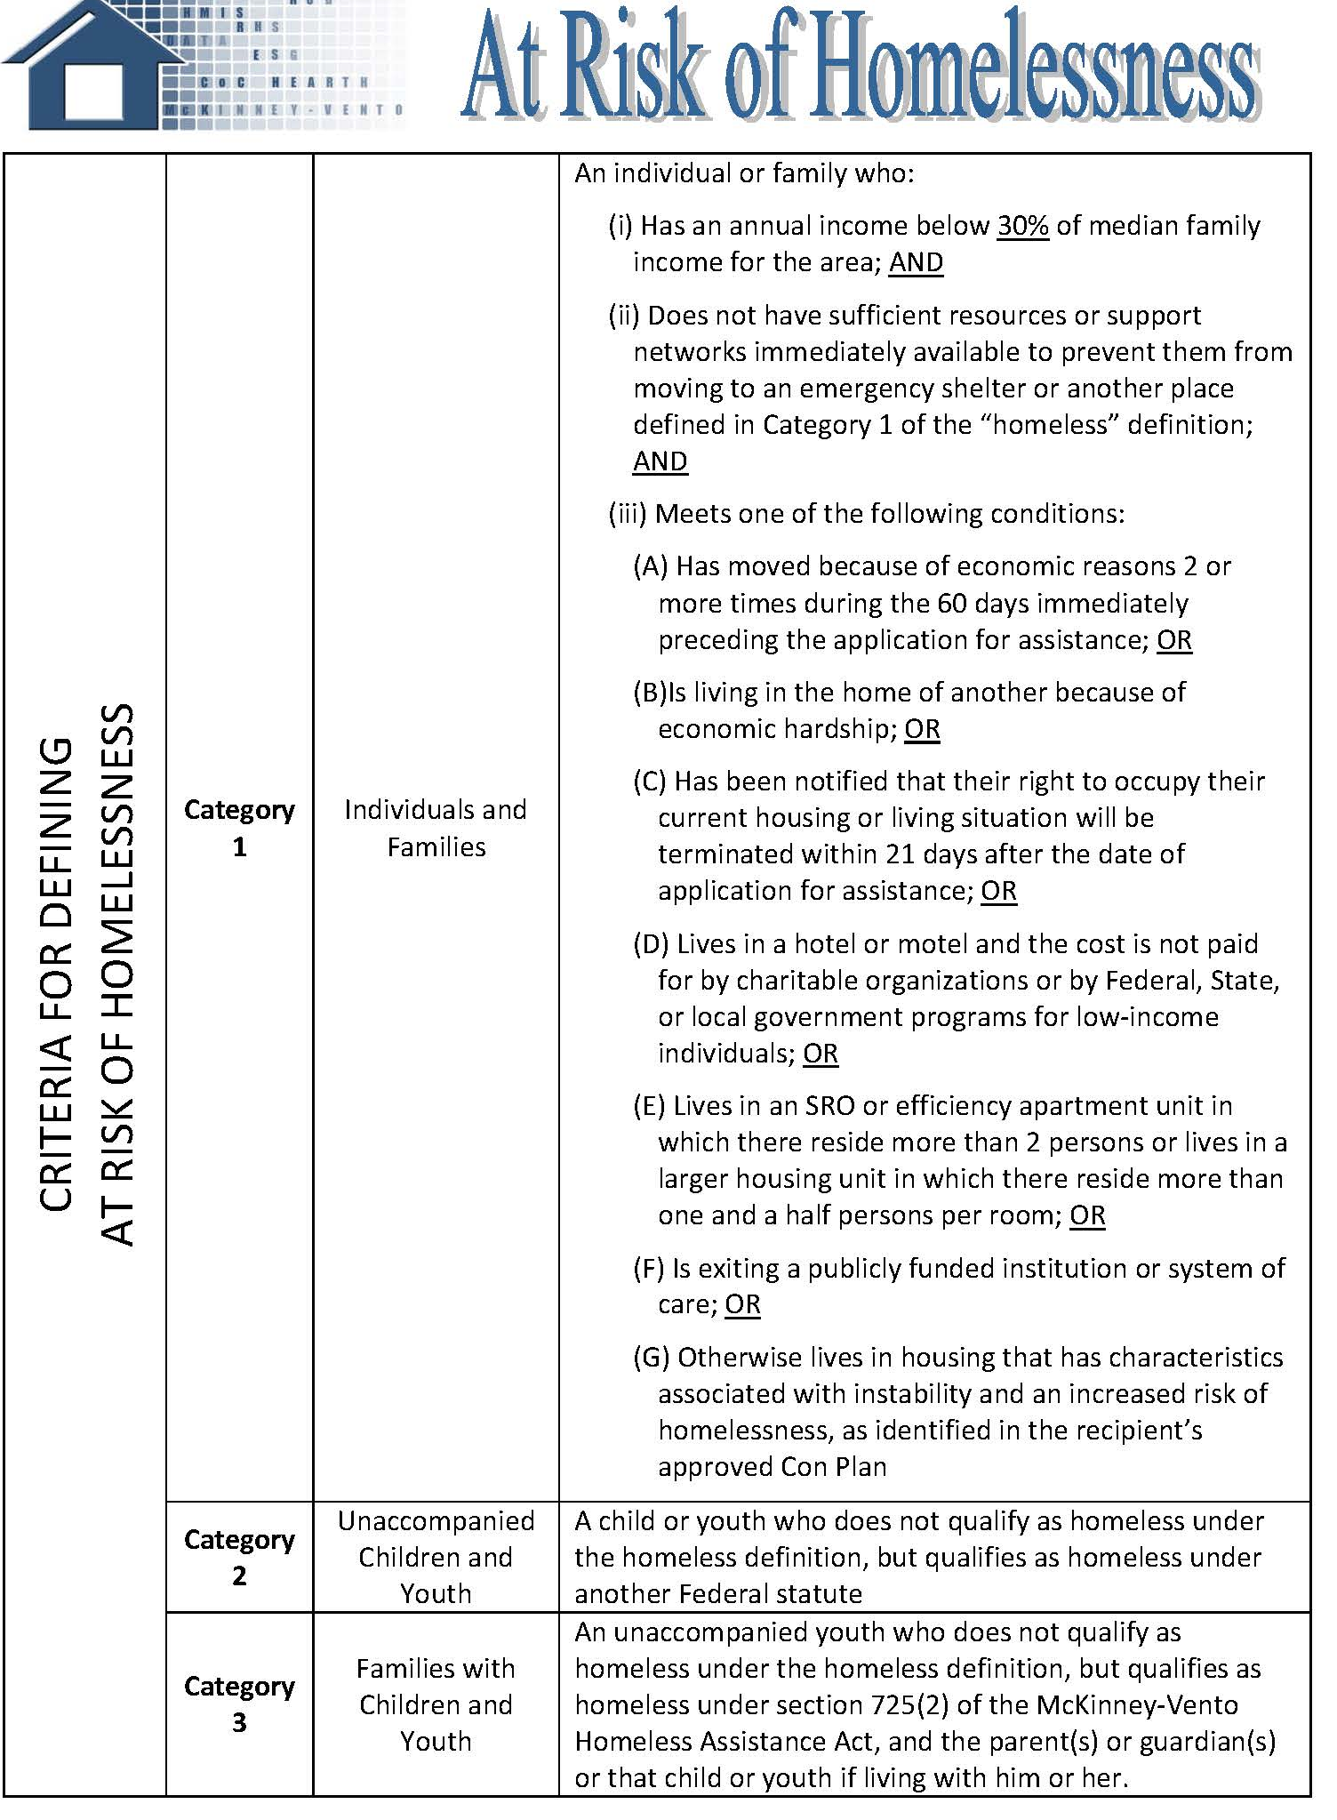
Who is eligible for EHV?
☐ Recently Homeless: The HH is currently residing in a Northwest MN CoC housing program (transitional, rapid, permanent supportive or other permanent housing) in which they entered through NWCOC Coordinated Entry AND were in a place not meant for human habitation OR emergency shelter prior to entry into the CoC housing program. Homeless Program Name:_________________________________
☐ Fleeing: The HH is currently fleeing or attempting to flee violence (domestic violence, dating violence, sexual assault, stalking, or human trafficking) OR staying in a shelter due to recently needing to flee AND have been assessed through NWCOC Coordinated Entry.
☐ Homeless: The HH is a in a place not meant for human habitation OR in a shelter AND has been assessed through NWCOC Coordinated Entry.
☐ At-Risk: The HH is at-risk of homeless, meaning they have less than 30% AMI AND are exiting an institution, have moved two times in the past 60 days due to housing instability, or is doubled-up due to economic hardship. This also includes families and youth eligible under McKinney-Vento Homeless Assistance Act and unaccompanied youth defined as homeless under other federal definitions.

Slide 6
What services is my client eligible for?
SERVICE
☐ Housing Search Assistance
☐ Application fees/non-refundable administrative or processing fees/refundable application deposit assistance.
☐ Holding Fees
☐ Security Deposit Assistance
☐ Utility Deposit Assistance / Utility Arrears
☐ Owner Recruitment and Outreach for EHVS
☐ Owner incentive and/or retention payments.
☐ Moving Expenses (Including move-in fees and deposits)
☐ Tenant-readiness services
☐ Essential Household Items
☐ Renters Insurance if required by the lease.
Notes:
Housing Search Assistance will typically be provided by an outside agency, usually the agency serving the client looking for housing.
Agencies will be asked “What can you provide?” This is to ensure we are not doubling up and providing all possible options to the client.

Slide 7
How do I refer my client to EHV?
Clients need to be referred to this program through the Coordinated Entry System.
For Clients who are Homeless, Fleeing, or At-Risk, Case Conferencing meetings are a great way to get referred. Case Managers from the NWCoC meet bi-weekly with three different meetings, Youth, East, and West to case conference about clients on the NWCoC priority list.
For Clients who are Fleeing DV ensure they are added to the Google Doc priority list. Or, e-mail Lori Anderson to come up with a plan for the referral.
For At-Risk clients there is no need to put them on the NWCoC Priority List, you can just bring the clients info to Case Conferencing meetings.
When in doubt (With this program only, other programs filled with standard referral process) you should e-mail Lori Anderson to see how to best get a client referred. Or you can refer to a NWCoC Access Site. If a youth you can refer to the MyPath Connect feature and someone will get in touch with them.
For Clients who are Recently Homeless and are ready for a Move On approach.
E-mail Lori Anderson and she will create a document to certify the referral.
You will need documentation that the person was Homeless before entering your project.
Overview of EHV Certification Document

Slide 8
Thank you for attending.
The information will be posted on the Housing Access / Coordinated Entry page of the NWCoC website under Training and Useful Tools.
https://www.nwmf.org/resources/strategic-partnerships/nwcoc/housing-access-coordinated-entry/
Northwest Continuum of Care (NWCoC) – Cory Boushee, COC Coordinator – coryb@nwmf.org; and
Lori Anderson, Priority List Manager- delores@tvoc.org
Northwest Multi-County Housing Authority – Karen Lunak, Housing Director - Karen@nwmnhra.org
HRA of Bemidji – Debbie Wold, Executive Director - hradw@midconetwork.com

